Slide 1
Object-Oriented Software Engineering
Practical Software Development using UML and Java
Chapter 5:
Modelling with Classes

Slide 2
Object Diagrams
Class diagrams tell us what classes will exist in a given system, but they are quite abstract.
Sometimes it can be hard to visualize the relationships among the objects that will exist at run-time.
An object diagram shows objects and links that may exist at a particular point during execution of a program.
Chapter 5: Modelling with classes

Slide 3
Object Diagrams
Objects are shown as rectangles, just like classes
      The difference is that the name of the class is underlined and preceded by a colon : Employee
      You can also give a name to each instance before the colon, as in Pat:Employee
      or even omit the class name entirely if it is clear from the context, such as Pat:
  A link between two objects is shown as a simple line.
Chapter 5: Modelling with classes

Slide 4
Object Diagrams
Object diagram is generated by a class diagram.
It contains instances and links of the classes and associations present in the class diagram.
      The numbers of links among instances are consistent with the multiplicity of that class diagram.
      A class diagram can generate an infinite number of object diagrams.
Chapter 5: Modelling with classes

Slide 5
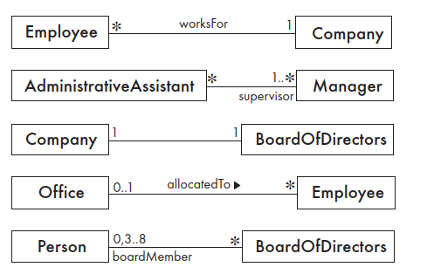
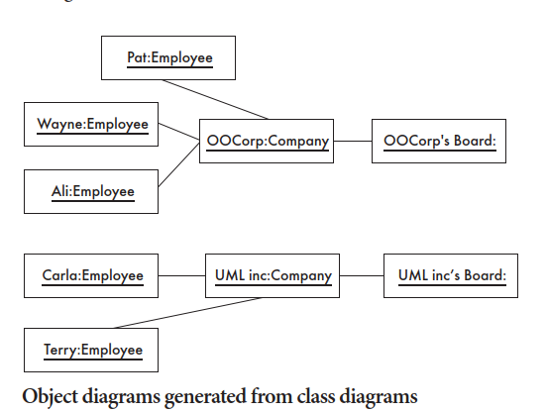
Object Diagrams
Figure shows object diagrams generated from two of the class diagrams
Class Diagrams
Chapter 5: Modelling with classes

Slide 6
Associations versus generalizations in object diagrams
  Associations describe the relationships that will exist between instances at run time.
    When you show an instance diagram generated from a class diagram, there will be an instance of both classes joined by an association.
  Generalizations describe relationships between classes in class diagrams.
    An object diagram can never contain a generalization.
Chapter 5: Modelling with classes

Slide 7
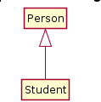

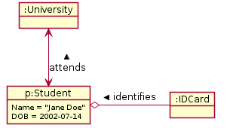
Object Diagrams
Chapter 5: Modelling with classes

Slide 8
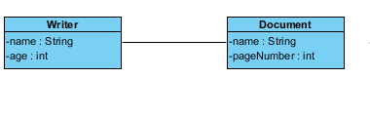
Exercise
Generate Object diagram from given class diagram
Chapter 5: Modelling with classes

Slide 9
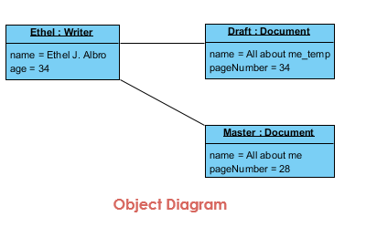
Solution
Chapter 5: Modelling with classes

Slide 10
Object-Oriented Software Engineering
Practical Software Development using UML and Java
Chapter 8:
Modelling Interactions and Behaviour

Slide 11
Interaction Diagrams
Interaction diagrams are used to model the dynamic aspects of a software system.
  They help you to visualize how the system runs.
  They show how a set of actors and objects communicate with each other to perform the steps of a use case, or of some other piece of functionality.
  The set of steps, taken together, is called an interaction.
  Interaction diagrams can show several different types of communication.
    E.g. method calls, messages send over the network
    These are all referred to as messages.
Chapter 5: Modelling with classes

Slide 12
Elements found in interaction diagrams
  Instances of classes
    Shown as boxes with the class and object identifier underlined
  Actors
    Use the stick-person symbol as in use case diagrams
  Messages
    Shown as arrows from actor to object, or from object to object
Chapter 5: Modelling with classes

Slide 13
Creating interaction diagrams
You should develop a class diagram and a use case model before starting to create an interaction diagram.
  There are two kinds of interaction diagrams:
    Sequence diagrams
    Communication diagrams
Chapter 5: Modelling with classes

Slide 14
Sequence diagrams
A sequence diagram shows the sequence of messages exchanged by the set of objects performing a certain task
  The objects are arranged horizontally across the diagram.
  An actor that initiates the interaction is often shown on the left.
  The vertical dimension represents time.
  A vertical line, called a lifeline, is attached to each object or actor.
  The lifeline becomes a broad box, called an activation box during the live activation period.
  A message is represented as an arrow between activation boxes of the sender and receiver.
    A message is labelled and can have an argument list and a return value.
Chapter 5: Modelling with classes

Slide 15
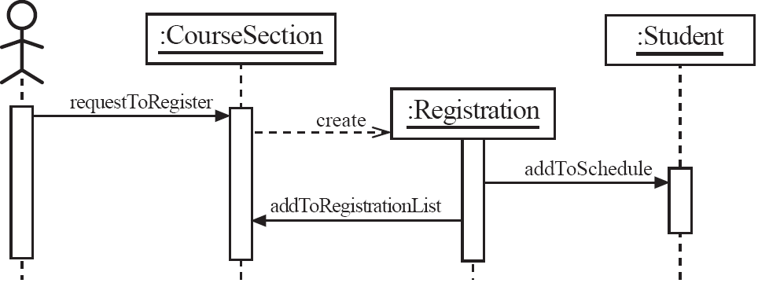
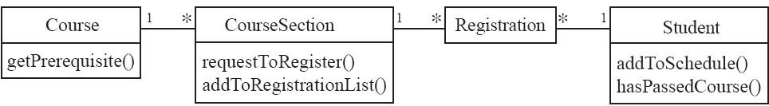
Sequence diagrams – an example
The actor initiates the interaction via the user interface;
Sends requestToRegister message to the CourseSection, which in turn creates a Registration. The Registration object then asks the Student to add it to the list ofcourses the student is taking, and also asks the CourseSection to add it to the list of registered students.
Chapter 5: Modelling with classes

Slide 16
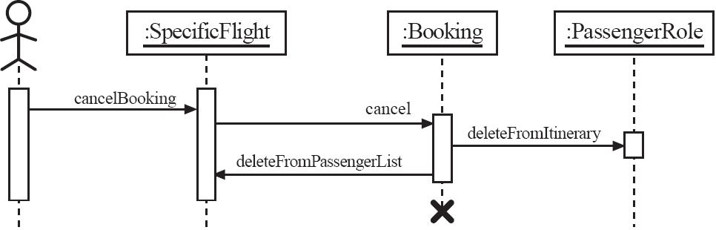
Sequence diagrams – an example with object deletion
  If an object’s life ends, this is shown with an X at the end of the lifeline
Chapter 5: Modelling with classes

Slide 17
Exercise 1
Draw a sequence diagram that represents the process of exam conduction described in the case study below:
Before the exam conduction, the instructor first informs the students of the exam date and the syllabus (material) included as part of exam. The instructor then prepares the exam paper. The instructor then gets the exam paper copied from staff to produce enough copies for the students, and later the instructor hands over the exam paper to the students on the designated time and location.
The students are required to write their answers against questions listed in the exam paper. Students should hand in their solution sheet to the instructor before time runs out.
The instructor then gives the solution sheet of students to the Teaching Assistance (TAs), along with sample solutions to each question, and gets them to mark it. TAs then return solution Sheet to instructor after marking. She then records all marks and inform result to the students.
Chapter 5: Modelling with classes

Slide 18
Exercise 2
A client searches for a book in a library. He or she then asks to borrow the book. If a copy of this book is available, a loan object is created.
Chapter 5: Modelling with classes

Slide 19
Communication diagrams
A communication diagram shows several objects working together.
A communication diagram is very much like an object diagram except that lifelines, activation boxes and combined fragments are absent.
you draw a communication link between each pair of objects involved in the sending of a message; the messages themselves are attached to this link.
Chapter 5: Modelling with classes

Slide 20
Communication diagrams – an example
Chapter 5: Modelling with classes

Slide 21
State Diagrams
A state diagram describes the behaviour of a system, some part of a system.
  At any given point in time, the system or object is in a certain state.
    Being in a state means that it will behave in a specific way in response to any events that occur.
  Some events will cause the system to change state.
    In the new state, the system will behave in a different way to events.
Chapter 5: Modelling with classes

Slide 22
States
  A state is represented by a rounded rectangle containing the name of the state.
  Special states:
    A black circle represents the start state
    A circle with a ring around it represents an end state
Chapter 5: Modelling with classes

Slide 23
Transitions
  A transition represents a change of state in response to an event.
  The label on each transition is the event that causes the change of state.
Chapter 5: Modelling with classes

Slide 24
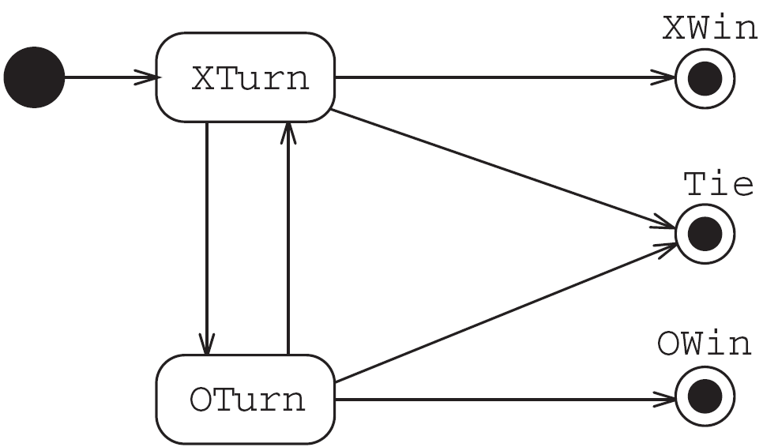
State diagrams – an example
  tic-tac-toe game (also called noughts and crosses)
  Player X always goes first, the initial transition from the start state
  points to the ‘X Turn’ state. From then on, the game alternates between ‘X Turn’ and ‘O Turn’ states, until the game ends.
  There can be three possible outcomes of the game, represented by the three end states:
  X can win, O can win or there
  can be a tie. The ‘Tie’ end state can be reached from both ‘X Turn’ state and ‘O Turn’ state.
Chapter 5: Modelling with classes

Slide 25
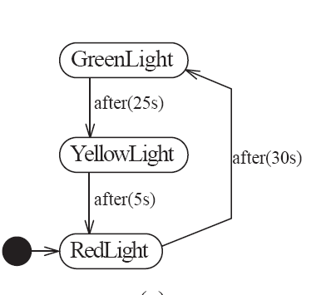
State diagrams – an example of transitions with time-outs(elapsed-time transitions to model a simple traffic signal)
Chapter 5: Modelling with classes

Slide 26
Activities in state diagrams
  An activity is something that takes place while the system is in a state.
    The system may take a transition out of the state in response to completion of the activity
    Some other outgoing transition may result in:
      The interruption of the activity, and
      An early exit from the state.
  An activity is shown textually within a state box by the word ‘do’ followed by a ‘/’ symbol, and a description of what is to be done.
Chapter 5: Modelling with classes

Slide 27
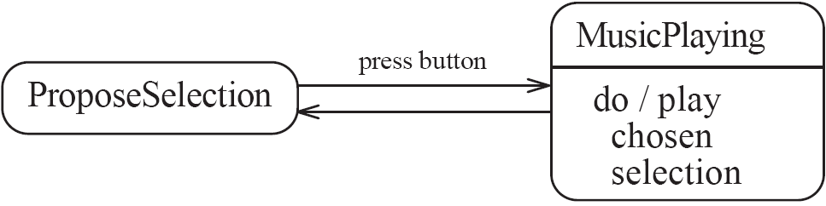
State diagram – an example with activity
Figure shows a jukebox with just two states. In ‘ProposeSelection’ state, the system waits for the user to press a button, selecting some music. In the ‘MusicPlaying’ state, the system plays the chosen music until it comes to an end. The system then takes a transition back to ‘ProposeSelection’ state.
Chapter 5: Modelling with classes

Slide 28
Actions in state diagrams
  An action is something that takes place effectively instantaneously
    When a particular transition is taken
    Upon entry into a particular state
    Upon exit from a particular state
  An action is always shown preceded by a slash (‘/’) symbol. If the action is to be performed during a transition, then the syntax is event/action.
  If the action is to be performed when entering or exiting a state, then it is written in the state box with the notation enter/action or exit/action.
Chapter 5: Modelling with classes

Slide 29
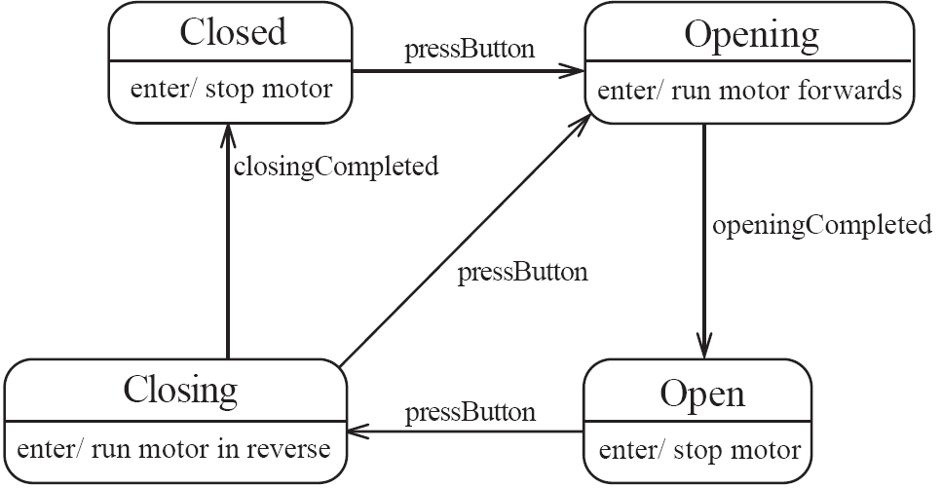
State diagram – an example with actions
Figure illustrates the use of actions in the state diagram for a garage door opener. Upon entry into each state, a particular action occurs that has an effect on the garage door motor.
Chapter 5: Modelling with classes

Slide 30

State diagrams – an example with conditional transitions
Chapter 5: Modelling with classes

Slide 31
Exercise
Draw State machine diagram of ATM
Chapter 5: Modelling with classes

Slide 32
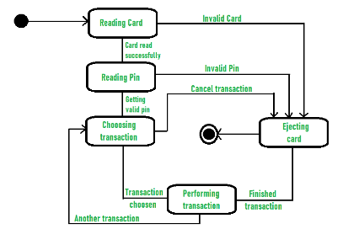
Chapter 5: Modelling with classes

